Slide 1
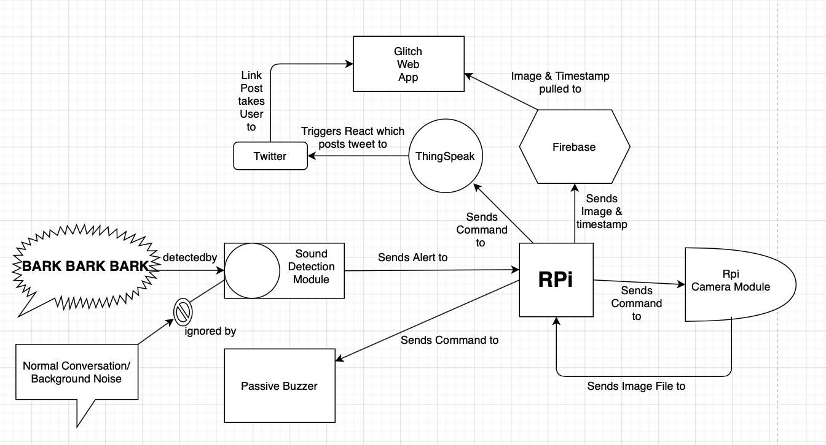
Informational Flow Diagram

Slide 2


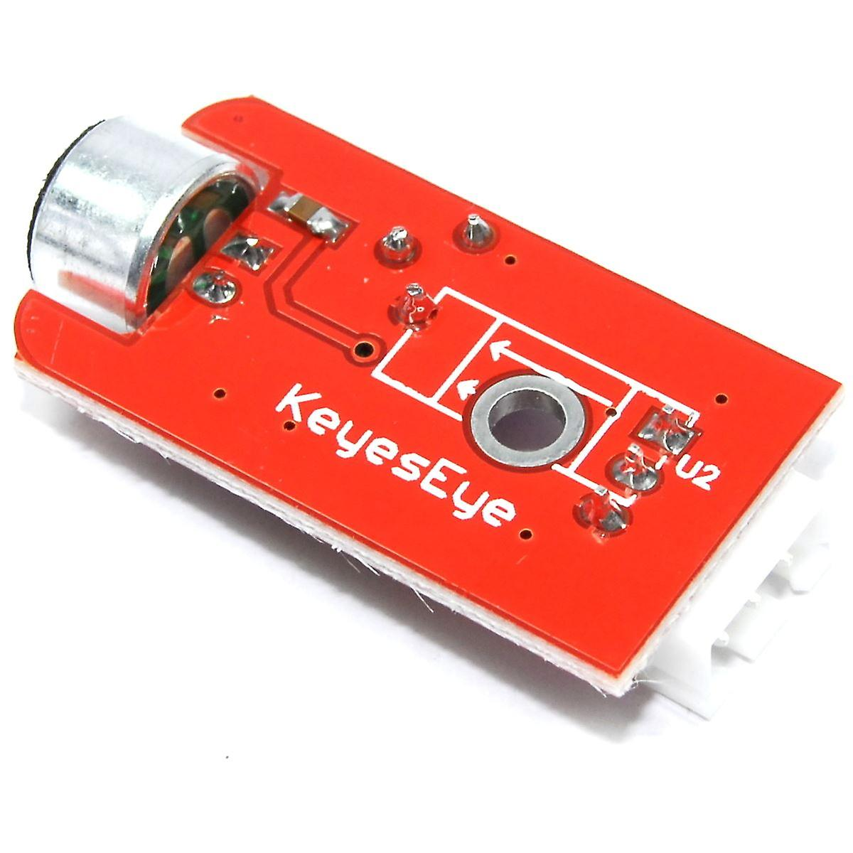
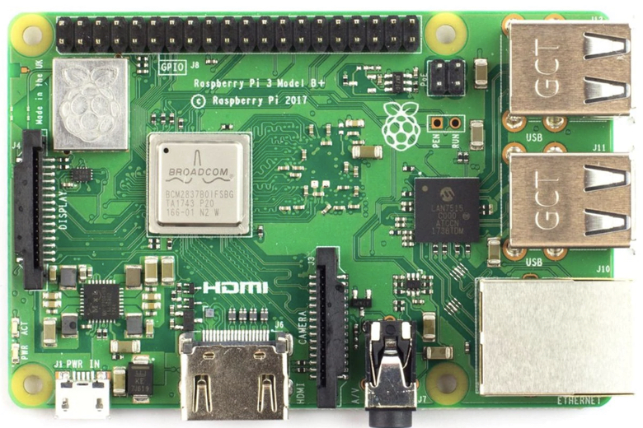

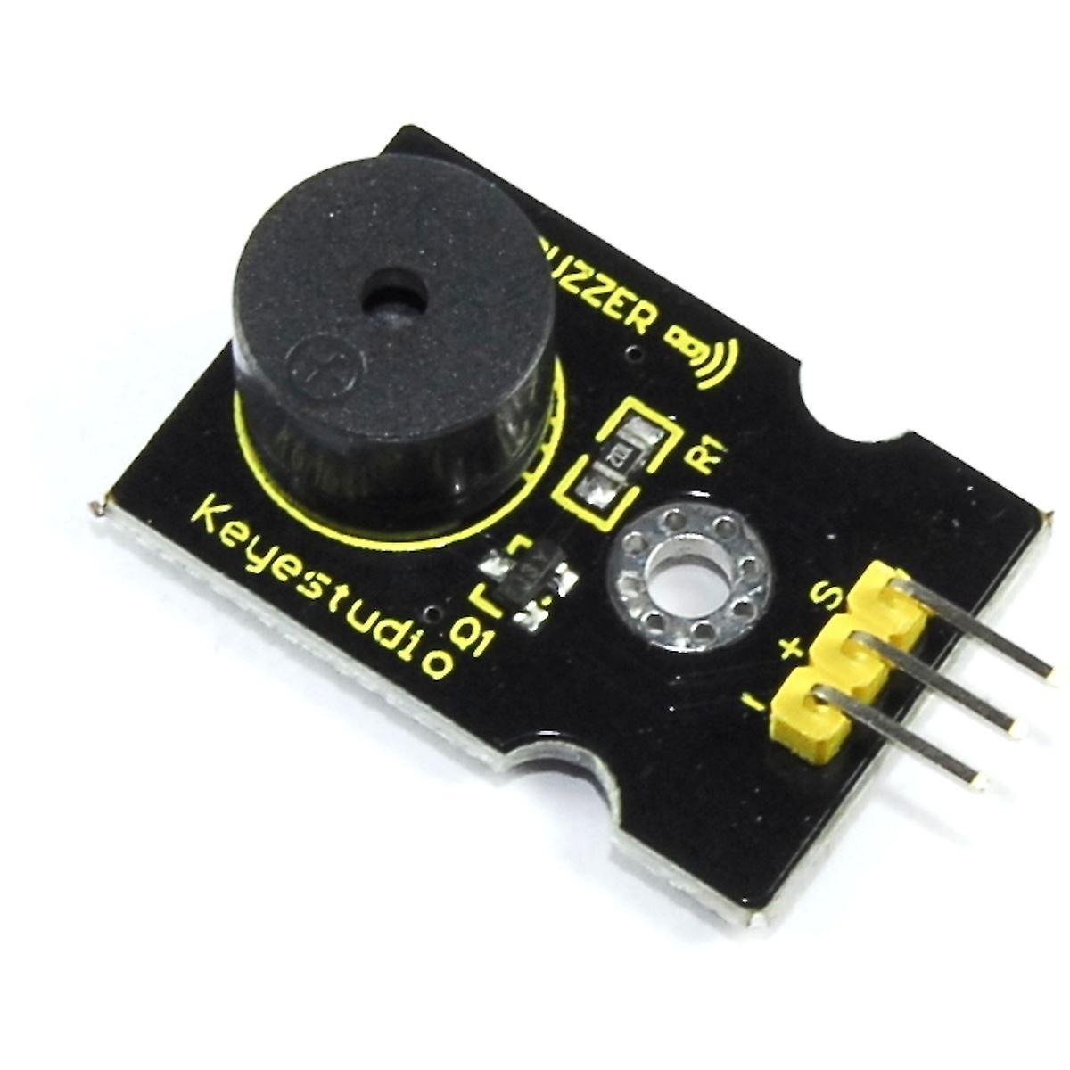
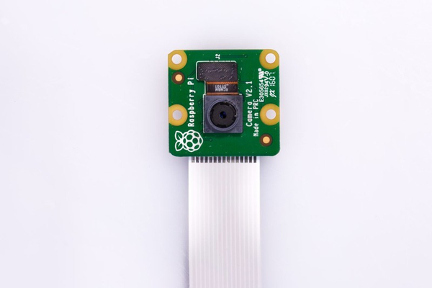





Pictorial (Block Level) Diagram
Keyes Funduino Sound Detection Module (SDM), wired to RPi 3B+ which is running a “listening” python script. Script is waiting for a sound of a particular Decibel Level to occur (between 80-90dB). Dog begins barking (normally from an external stimulus). Sound Detection Module takes in Dog Bark and sends the alert to the RPi.
Rpi 3 B+ connected to SDM, PBM, Rpi Camera Module V2 and Home Wi-Fi Router using 802.11 protocol. “sensorX.py” Script is running on RPi. When Sound of particular dB range occurs, “buzz” command is triggered telling PBM to buzz. At time of “buzz” command being triggered, “photo” command is also triggered, telling Camera Module to take photo.
RPi sends “buzz” Command to Keyestudio Passive Buzzer Module (PBM), telling it to buzz at a particular frequency, that would distract the dog.
When Barking is Detected the Camera takes an Image and timestamp and sends them along with an Alert stating “Dog has begun barking”
Image & Timestamp captured are sent to Glitch Web App to be displayed.
When Barking is Detected, RPi sends Command to Camera Module to Capture an Image. Image is captured and sent back to the RPi
Data/Images is received to Firebase Realtime Database
A ThingTweet is sent to a Twitter Account containing an Alert Message and a link to the Glitch Website. The Dog Owner is Subscribed to the Twitter Account so they receive a Notification to view the Tweet, so they’re aware their dog is barking.
Data and Image are received by ThingSpeak

Slide 3
Logic Algorithm Flowchart
Listening
Has Dog Started Barking?
No?
Yes?
Take Photo
Send Alert with Photo
Buzz for 5 Secs
Is Dog Still Barking?
Yes?

